Slide 1
SMART BAGGAGE TRACKER

Slide 2
CONTENTS
INTRODUCTION
WORKING PRINCIPLE
SECURITY AND PRIVACY
REAL TIME APPLICATIONS
COMPATIBILITY BENEFITS AND FEATURES APPLICATIONS

Slide 3

INTRODUCTION
This IoT-based smart baggage track device gives passengers the advantage of seeing the current location of their baggage from anywhere in the world.

Slide 4
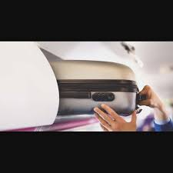
WORKING PRINCIPLE
Sensors and Connectivity IOT: Devices equipped with sensors transmit data to a centralized system, allowing for precise location tracking.
Data Processing: The collected data is processed and analyzed to provide accurate and real-time information about baggage location.
Integration: IoT technology integrates with airline systems, mobile apps, and backend services for seamless baggage tracking.

Slide 5
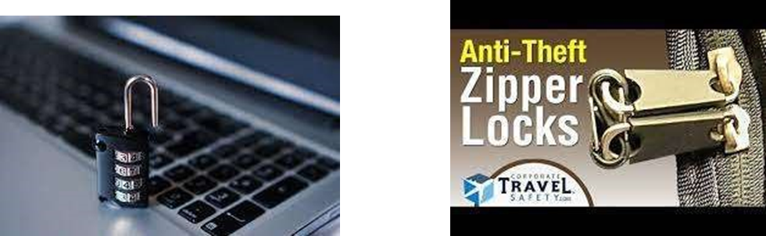
Biometric Locks: Advanced biometric locking systems prevent unauthorized access to the luggage, enhancing security.
Alert Notifications: Instant alerts and notifications are sent if the luggage is tampered with or moves without authorization.
Secure Zippers: Equipped with tamper-proof zippers to safeguard belongings and deter theft attempts during travel.
SECURITY AND PRIVACY

Slide 6
Instant Updates:
Get real-time location updates, ensuring you're always informed about the where abouts of your luggage.
Historical Tracking:
Access historical data to review the journey of your baggage and identify any irregularities or delays.
Geolocation Services:
Precise geolocation services provide accurate tracking, offering peace of mind to travelers.
REAL-TIME APPLICATIONS

Slide 7
Suitcases:
Smart Baggage Tracker is compatible with traditional suitcases of various sizes and materials, providing peace of mind for travelers.
Backpacks:
It seamlessly integrates with backpacks, ensuring security and tracking functionality for outdoor enthusiasts and adventure seekers.
Duffel Bags:
Designed to fit duffel bags and sports gear, offering comprehensive protection and monitoring for active travelers.
Briefcases:
Compatible with professional briefcases, ensuring business travelers can maintain oversight of their important documents and equipment.
COMPATIBILITY

Slide 8
Enhanced Security: Real-time tracking and anti-theft measures ensure the safety and security of luggage during travel.
Enhanced Security: Real-time tracking and anti-theft measures ensure the safety and security of luggage during travel.
Peace of Mind: Provides peace of mind by offering instant notifications and updates about the location and condition of baggage.
BENEFITS OF USING SMART BAGGAGE TRACKER

Slide 9
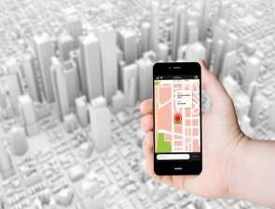

1. Multi-airline Compatibility
2. Anti-theft Measures
3. Mobile App Integration
4. Real-time Tracking
5. Geo-fencing Technology
FEATURES OF SMART BAGGAGE TRACKER

Slide 10
* Smart Baggage Trackers have a wide range of applications, from personal travel to commercial shipping.
* They are used to track the location and condition of baggage, ensuring peace of mind for travelers and efficiency for logistics companies
APPLICATIONS

Slide 11
THANK YOU

